Slide 1
Process Management
Introduction, Life Cycle, PCB

Slide 2
What is a Process
It is basically a program in execution
It is very important to understand the difference between a program and a process.
Process is not as same as program code but a lot more than it. A process is an 'active' entity as opposed to program which is considered to be a 'passive' entity.
For example: Consider a c program “example.c”. It is stored in the disk space. For a program to be executed it has be in the main memory. Operating system will take this program and put it in main memory. When it is put in the main memory it creates some structure, a data structure which is created by an OS for execution of a program.

Slide 3
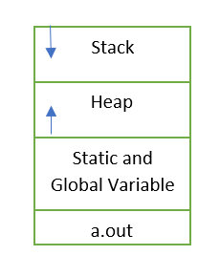
Layout of a Process in Memory
Process memory is divided into four sections for efficient working :

Slide 4
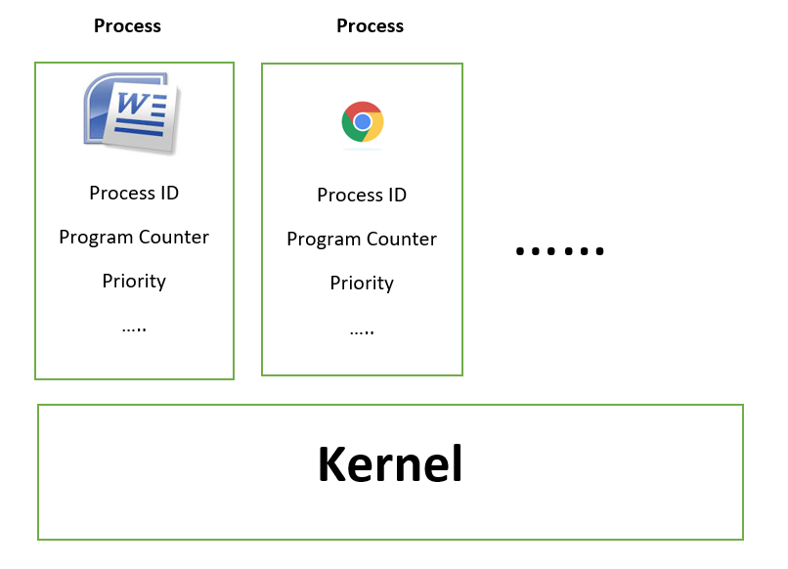
Process Control Block
There are so many processes in the system.
How to recognize each process in the system?
For this we have attributes of a process.

Slide 5
Process Control Block
Attributes of a process are:
Process ID
Program Counter
Process State
Priority
General Purpose Registers
List of Open files
List of open devices
Protection
PCB

Slide 6
States of a process
New
Ready
Running
Waiting
Terminate

Slide 7
Process scheduling and process queues
Types of schedulers in OS
  Long term scheduler
  Short term scheduler
  Medium term scheduler
Types of process queues
  Job Queue
  Ready Queue
  Device Queue

